Slide 1
Breast cancer classification
Pattern Recognition – deep learning project
Fine-tuning a Convolutional Neural Network, trained on ImageNET, using augmented mammographic screening data
Group 18
Harmen Heida, Job Heuvelmans, Francesco Pontiggia, Xin Lan and Jiayuan Hu

Slide 2
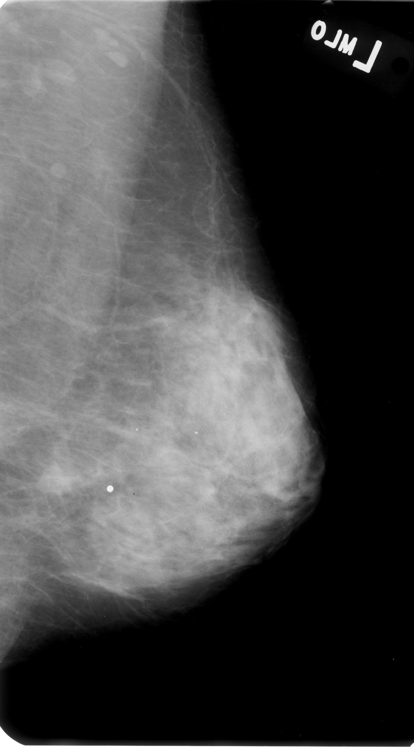
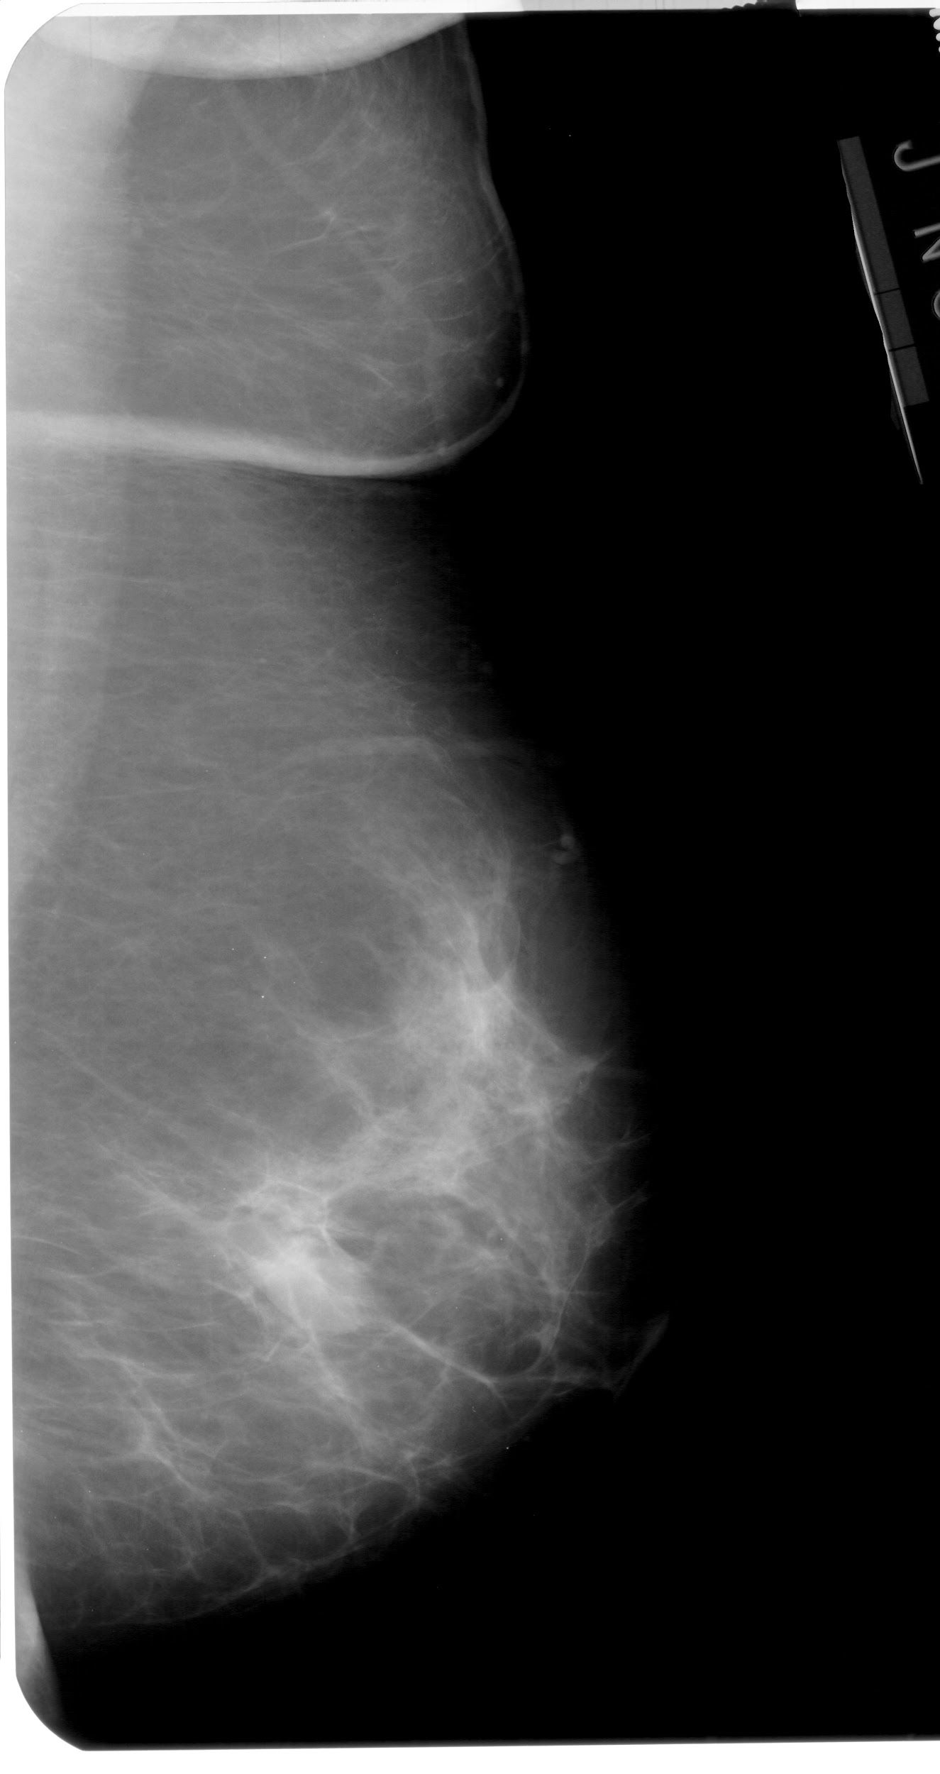
Overview
Introduction
Breast cancer screening
Related work
Our goal
Approach
Dataset
Transfer learning
Model
Data augmentation
Conclusion
Results
Discussion
Source: R. S. Lee, (2016), Curated Breast Imaging Subset of DDSM [Dataset]
Notes:
Breast cancer screening is effective to prevent morbidity or mortality ¹
Screening through mammographies + radiologists ²
Around 30% of them are interpreted wrongly ²
→ Computer-Aided Diagnosis (CAD)³
First (1980) hand crafted
Since (2012) CNN
Wrongly due to: The causes are the complex structures of breast tissues, oversights, poor quality films, and eye fatigue (so partly due to human errors

Slide 3
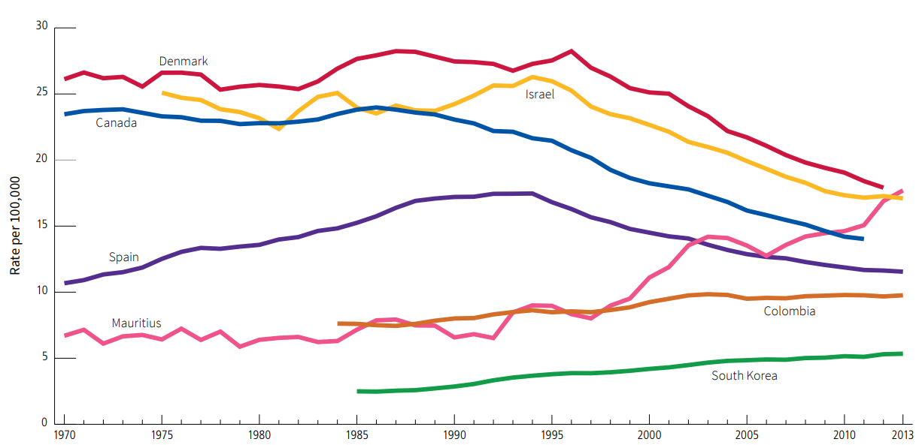
Breast cancer screening
Screening is effective to prevent morbidity and mortality ¹
CAD based on CNN enables early breast cancer detection with high performance ^{2, 3}
1. Tabár, L. (1999). The natural history of breast carcinoma: what have we learned from screening? 2. Doi, K. (1997). Computer aided diagnosis of breast cancer on mammograms. 3. Gardezi, S. J. S., Elazab, A., Lei, B., & Wang, T, (2019), Breast cancer detection and diagnosis using mammographic data: Systematic review. Figure source: American Cancer Society. 2018. Global Cancer: Facts & Figures, 4th edition
Notes:
Breast cancer screening is effective to prevent morbidity or mortality ¹
Screening through mammographies + radiologists ²
Around 30% of them are interpreted wrongly ²
→ Computer-Aided Diagnosis (CAD)³
First (1980) hand crafted
Since (2012) CNN
Wrongly due to: The causes are the complex structures of breast tissues, oversights, poor quality films, and eye fatigue (so partly due to human errors

Slide 4
Our goal
Improve performances in a situation of little data and little computational power
Explore the state of the art techniques
Pattern recognition using:
CNN
Transfer learning
Data augmentation
Especially evaluate data augmentation
Breast cancer classification

Slide 5
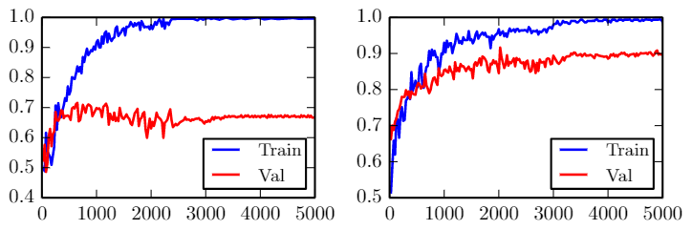
Related work
Method: Transfer learning with shallow CNN, AlexNet, GoogLeNet¹
No data-augmentation
Data augmentation
Source and reference: 1.Daniel Lévy, Arzav Jain, (2016), Breast Mass Classification from Mammograms using Deep Convolutional Neural Networks

Slide 6
Dataset
 | Benign ( 59.19% ) | Malign ( 40.80% ) | Total
Train ( 80.26% ) | 1683 ( 58.81% ) | 1179 ( 41.19% ) | 2862
Test ( 19.74% ) | 428 ( 60.79% ) | 276 ( 39.20% ) | 704
Total | 2111 | 1455 | 3566
Breast cancer screening X-ray data*
Mass segmentation and bounding boxes
Pathologic diagnosis for labels
* Open available via: R. S. Lee, (2016), Curated Breast Imaging Subset of DDSM [Dataset]. The Cancer Imaging Archive.
Notes:
Digital Database for Screening Mammography
Input (x): Region of interest (ROI) matrices
Labels (y):
1: Malign
0: Benign
WE SHOULD ALSO TELL THAT THEY STANDARDIZED THE TRAIN AND TEST SUCH THAT EVERYBODY REPORTS THE SAME TEST ACCURACY’s ( what does it mean?)

Slide 7
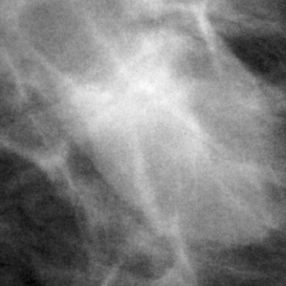
Benign
Source: R. S. Lee, (2016), Curated Breast Imaging Subset of DDSM [Dataset]
Notes:
Chosen by experts
Labels after surgery , looking under microscope, pathology data

Slide 8
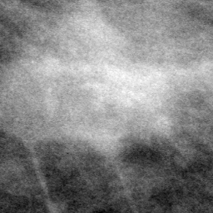
Malignant
Source: R. S. Lee, (2016), Curated Breast Imaging Subset of DDSM [Dataset]
Notes:
Chosen by experts
Malignant is less smooth.
Labels after surgery , looking under microscope, pathology data

Slide 9
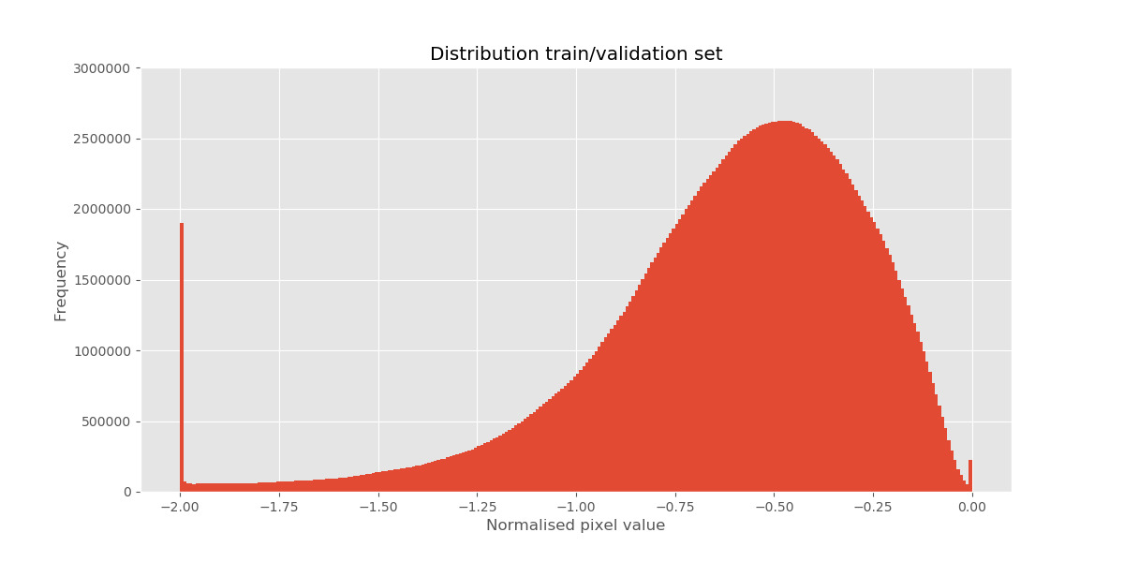
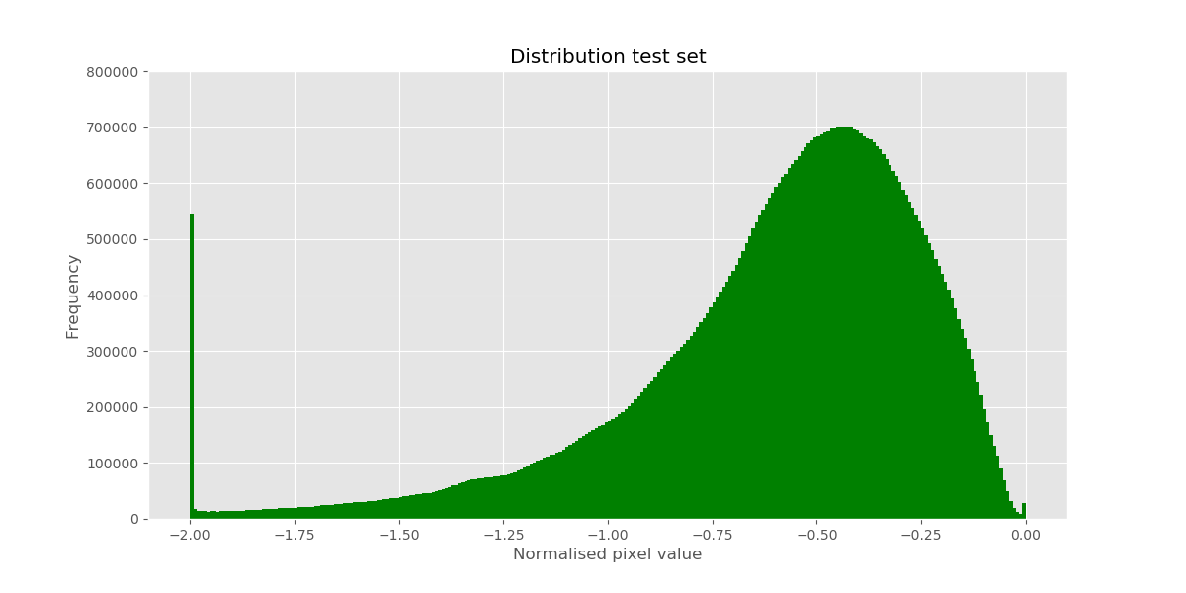
Data distribution
Min-max normalised input to [-2,0]
The data is skewed
Source: R. S. Lee, (2016), Curated Breast Imaging Subset of DDSM [Dataset]
Notes:
The input was first min-max normalised from the standard DICOM file format, this method does not take into account skewness of the input.
Data was normalised to [-2,0], this had the best convergence rate effect on the Inception v3 model, and was recommended by some papers to use i.c.w. this model.
Data is skewed, this could have an effect on the rate of convergence. This effect could be further explored in the future.

Slide 10
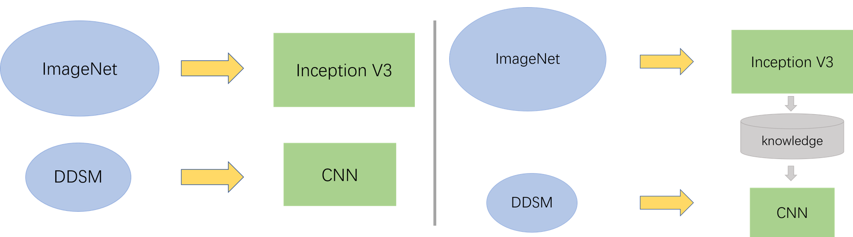
Why transfer learning?
Small dataset i.c.w. overfitting ^{1,2}
Limited computational resource
Versus random initialization ³
Traditional
Transfer learning
References:1. Halevy A, Norvig P, Pereira F. The unreasonable effectiveness of data. IEEE Intell Syst.; 2.Nicolas Yu,Yaoqin Xie,(2017),Breast mass lesion classification in mammograms by transfer learning 3..H. Chougrad et alia, (2018), Deep Convolutional Neural Networks for breast cancer screening.
Notes:
Use a model pre-trained on ImageNet and just fine-tune the upper few layers
bottom layers detect general features of images, like lines and boundaries of objects, so keep the ones trained on a bigger dataset
upper layers detect specific features for the task, so contextualize the model

Slide 11
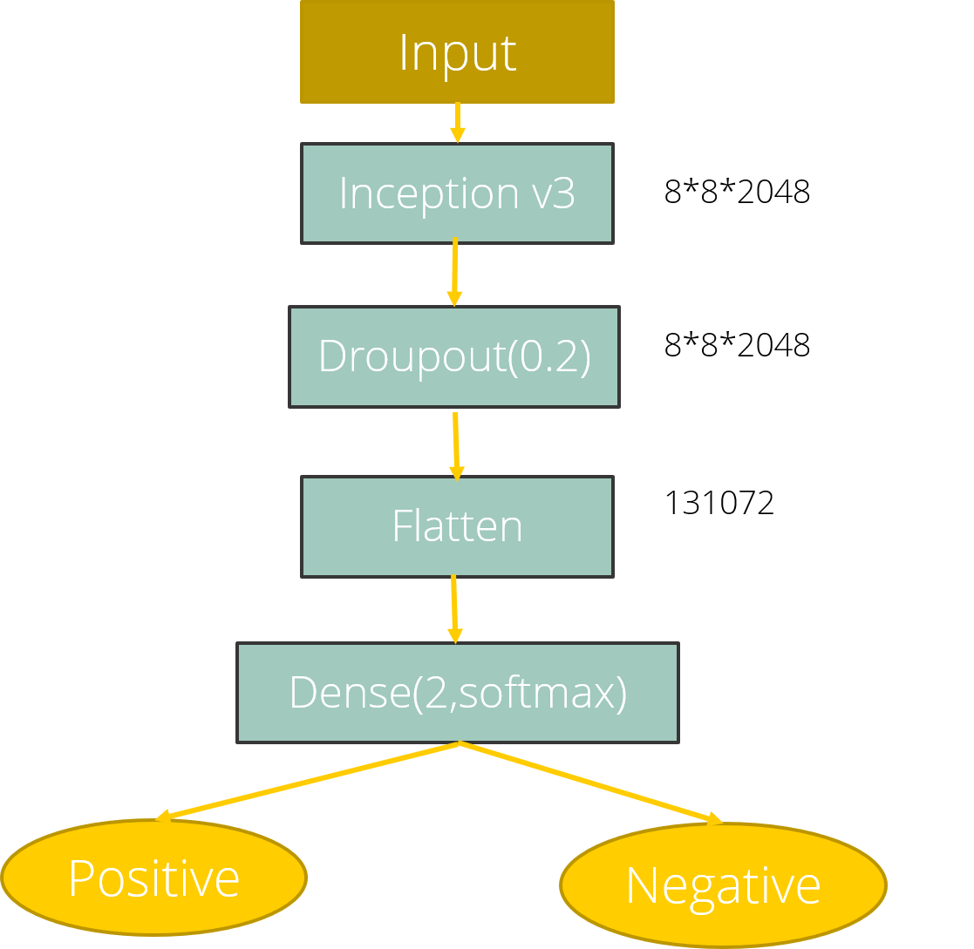
State of the art model and transfer learning
Inception V3 ¹
Trained on ImageNet
Fastest in training
Good performer in all the state of the art models^{2,3}
References: 1.Christian Szegedy et alia, (2015), Rethinking the Inception Architecture for Computer Vision; 2.G. Litjens et alia, (2017), A survey on Deep Learning in Medical Image Analysis, 3.H. Chougrad et alia, (2018), Deep Convolutional Neural Networks for breast cancer screening. 4. Z. Jiao, (2016), A deep feature based framework for breast masses classification,
Notes:
Use a model pre-trained on ImageNet and just fine-tune the upper few layers
bottom layers detect general features of images, like lines and boundaries of objects, so keep the ones trained on a bigger dataset
upper layers detect specific features for the task, so contextualize the model

Slide 12
Data augmentation
Reduce overfitting (increase generalization) ^{1,2}
Online data augmentation (using ImageDataGenerator) ⁵
Operation | Value^{1,3,4}
Rotation | θ = ±20
Flips | True
Shear | ±0.35
Shifts | ±0.1
References 1. I. Goodfellow (2016), Deep Learning 2. C.Shorten, (2019), A survey on Image Data Augmentation for Deep Learning 3. Z. Hussain, (2018), Differential Data Augmentation Techniques for Medical Imaging Classification 4. H. Chougrad, (2018), Deep Convolutional Neural Networks for breast cancer screening 5. Chollet, F. (2016). Building powerful image classification models using very little data.
Notes:
Reduce overfitting (increase generalization) ^{1, 2}
Operations to get more data: ^{1, 3, 4}
CNN are not rotation invariant ¹
Different views of mass ³
Different shapes of mass ³
Online data augmentation (using ImageDataGenerator) ⁵
Batches consist of augmented images ⁵

Slide 13
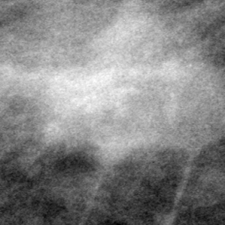
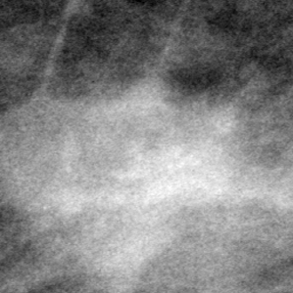
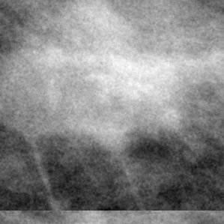
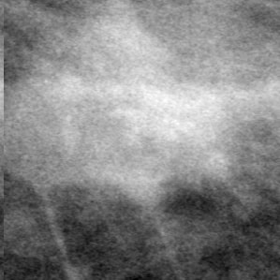

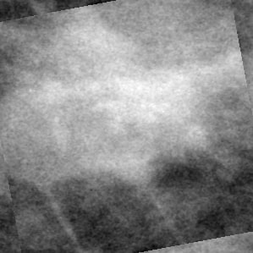
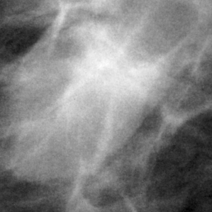
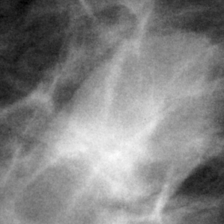
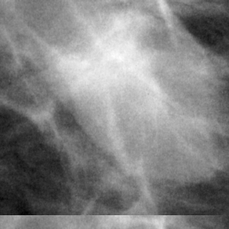
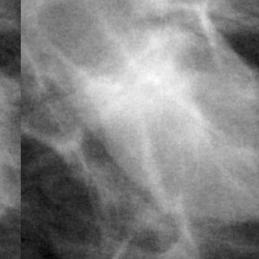

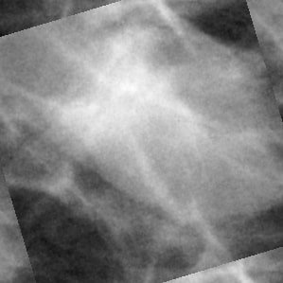
Malignant
Benign
Original
Horizontal flip
Vertical flip
Vertical shift
Horizontal shift
Shear
Rotation

Slide 14
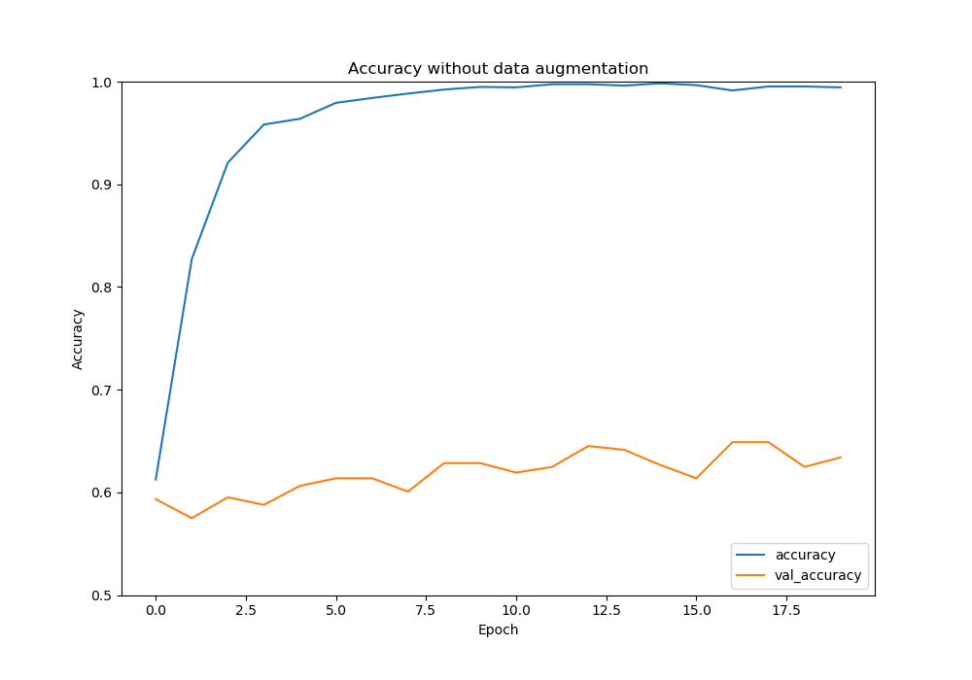
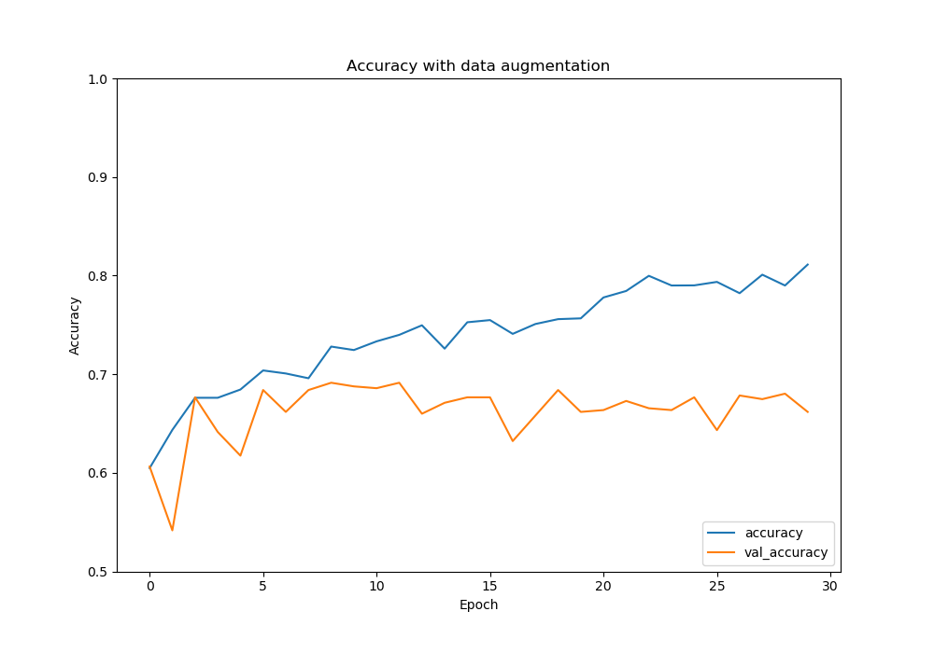
Results
Model overfits quickly without augmentation
Notes:
The results show a clear difference in the performance of the model with and without data augmentation.
The non-data augmented dataset shows that the model is too complex and almost immediately overfits and achieves train accuracies well above 99%.
The data augmentation fix this problem to an extent, the data achieves an overall higher validation accuracy and is more similar to the accuracy, it still overfits.

Slide 15
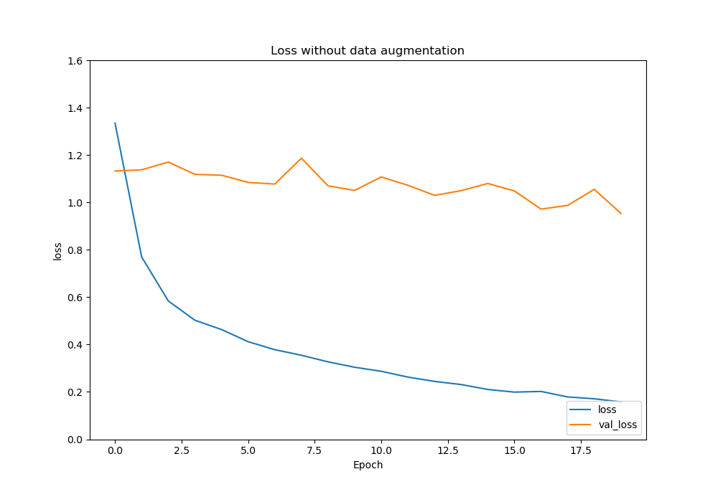
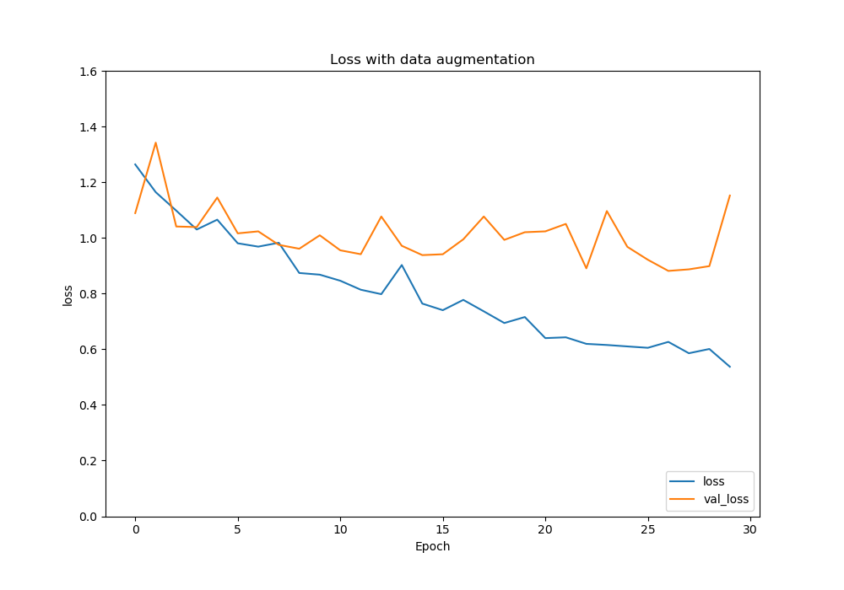
Results
No augmentation:
Loss diverges directly
Augmentation:
Loss diverges at epoch 7-8
Notes:
This overfitting trend is also clearly visible when tracking the loss.
We find that without data augmentation the model starts to overfit almost instantly.
With data augmentation we can conclude that the validation loss graph follows the loss graph more closely and thus is overfitting less.
At around 7-8 epochs we can see that the loss also begins to diverge at epoch 7 or 8. It seems like our dataset is too small to learn enough features before the model overfits.

Slide 16
Results
Without Augmentation test_acc = 0.604 |  | Predicted
 |  | Negative | Positive
Actual | Negative | 285 | 143
 | Positive | 136 | 140
~8% total increase in accuracy
Not a cure-all method
With Augmentation test_acc = 0.683 |  | Predicted
 |  | Negative | Positive
Actual | Negative | 335 | 93
 | Positive | 130 | 146
Breast cancer classification
Notes:
There is a significant increase in the total amount of accuracy. This increases from about 60.4% without data augmentation to 68.3% with data augmentation.
In the tables we find that most of this increase is related with an improved negative detection rate.
Data augmentation seems to improve the results even on a small dataset, it is however not a cure-all method.

Slide 17
Discussion
Small dataset
Little computational power
Incomplete information in other research and unavailable datasets
No agreement on transfer learning^{1,2}
References: 1. M. Raghu et alia, (2019), Transfusion: Understanding Transfer Learning for Medical Imaging. 2.Esteva e alia, (2017), Dermatologist-level classification of skin cancer with deep neural networks. Nature 542, 115–118.
Notes:
Small dataset:
↑ Overfitting
↓ Deep fine-tuning
↓ Specific trained on this data
↓ Performance
Little computational power:
↓ Batch size
↓ Fine tuning
↓ Performance
Incomplete information in other research and unavailable datasets:
Making it difficult to improve on earlier work
There is no agreement on transfer learning
Random initialization with better results and simpler model¹
Fine tuning the entire network²
However, we made the choices that produced the best performances for the breast cancer classification task in the literature

Slide 18
Future work
Replicability of investigations must be increased
Exploring other data augmentation techniques ^{1, 2, 3}
Comparing AI algorithms to radiologists’ performance ⁴
Explore possibilities with 3D images (digital breast tomosynthesis) ^{4, 5}
References: 1.E. Castro, (2018), Elastic Deformations for Data Augmentation in Breast Cancer Mass detection 2. Dimitrios Korkinof, (2019,) High-Resolution Mammogram Synthesis using Progressive Generative Adversarial Networks 3.Guotai Wang, (2018),Test-time augmentation with uncertainty estimation for deep learning-based medical image segmentation 4. N. Houssami, (2019), Artificial Intelligence (AI) for the early detection of breast cancer: a scoping review to assess AI’s potential in breast screening practice 5. G. Litjens et alia, (2017), A survey on Deep Learning in Medical Image Analysis
Notes:
Replicability of investigations must be increased
Exploring other data augmentation techniques, such as:
Elastic deformations as researched ¹
GAN-based medical image augmentation ²
Test-time augmentation ³
Comparing AI algorithms to radiologists’ performance ⁴
Explore possibilities with 3D images (digital breast tomosynthesis) ^{4, 5}

Slide 19
Questions? Thank you for listening!
Group 18
Harmen Heida, Job Heuvelmans, Francesco Pontiggia, Xin Lan and Jiayuan Hu
Breast cancer classification

Slide 20
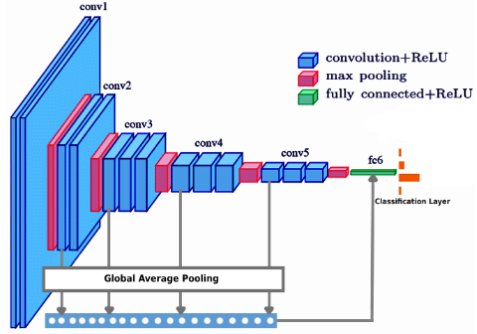
Related work
Inspiration:
Deep-CNN with transfer learning¹
Global average pooling fed into a multilayer perceptron classifier¹
References: 1.S.H.Kassani, et al. (2019), Breast Cancer Diagnosis with Transfer Learning and Global Pooling
Notes:
Using inception V3. 89%
Added global average pooling which improved inception V3.
ICIAR 2018 Grand Challenge 400

Slide 21
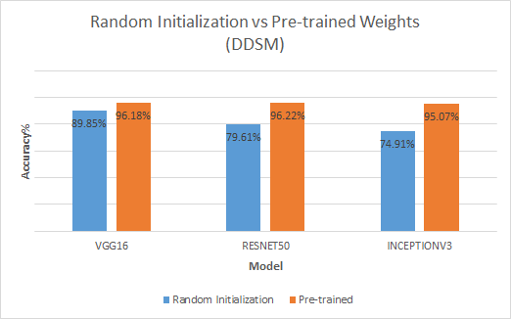
ReferencSource: H. Chougrad et alia, (2018), Deep Convolutional Neural Networks for breast cancer screening.

Slide 23
Input
Inception v3
8*8*2048
Droupout(0.2)
8*8*2048
Flatten
131072
Dense(2,softmax)
Positive
Negative

Slide 25
Breast cancer detection
Method | Task | Performance metrics
AlexNet and GoogleNet (transfer learning) | Breast mass classification | Accuracy (0.924),Precision (0.924), and Recall (0.934)
Multistage fine-tuned CNNc (transfer learning) | Classification | AUC (0.91)
GAN and ResNet50 | Detection and classification of benign and malignant | AUC (0.896)
Reference: Gardezi, S. J. S., Elazab, A., Lei, B., & Wang, T, (2019), Breast cancer detection and diagnosis using mammographic data: Systematic review.
Notes:
CAD based on CNN enables early breast cancer detection with high

